Slide 1









2026
- A.I. SUMMIT -
Customer Churn Analysis
Customer Churn
Analysis & Retention Strategy (IBM Telco Dataset)
Author: Lauretta Hayford

Slide 2

2026
- A.I. SUMMIT -
Customer Churn Analysis
Table of Contents
01
Project Overview
02
Dataset Overview
03
Tools & Data Cleaning
04
Key Analysis Areas
05
Key Findings
06
Dashboard Visualizations
07
Recommendations
08
Conclusion

Slide 3






2026
- A.I. SUMMIT -
Customer Churn Analysis
Project Overview
Business Problem
Objective
Key Focus Areas
Telecommunication companies lose customers regularly, which affects revenue and long-term growth.
Identify the major customer behaviors that predict churn and recommend strategies to improve retention.
Customer tenure
Contract type
Monthly charges
Service usage

Slide 4




2026
- A.I. SUMMIT -
Customer Churn Analysis
Dataset Overview
Data Source
Data Includes
IBM Telco Customer Churn Dataset (Kaggle)
Customer demographics
Size
Services subscribed to
7,000+
21
Billing/payment information
Records
Columns
Contract details
Churn status

Slide 5
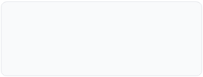
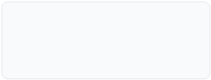
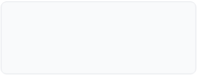




2026
- A.I. SUMMIT -
Customer Churn Analysis
Tools and Data Cleaning
Tools Used
Excel
MySQL
Power BI
R Online
Data Cleaning Steps
Removed duplicates
Checked missing values
Converted TotalCharges to numeric
Standardized categorical fields
Removed blank spaces and formatting issues

Slide 6
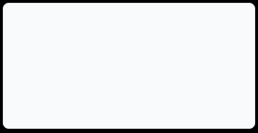


2026
- A.I. SUMMIT -
Customer Churn Analysis
Key Analysis Areas
Questions Investigated
01
02
03
Which contract types have the highest churn?
Does customer tenure affect churn?
Do higher monthly charges increase churn?
04
05
Which services reduce churn risk?
Which payment methods are associated with churn?

Slide 7
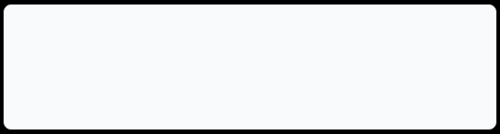



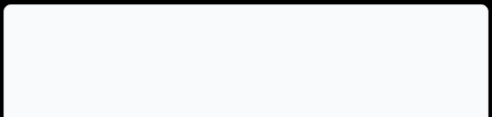
2026
- A.I. SUMMIT -
Customer Churn Analysis
Key Findings
Major Insights
Month-to-month contracts had the highest churn rate
Customers with shorter tenure churned more often
Higher monthly charges increased churn likelihood
Customers without tech support and online security churned more
82%
Electronic check users showed higher churn rates
Insight Correlation

Slide 8


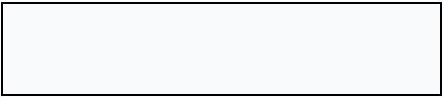
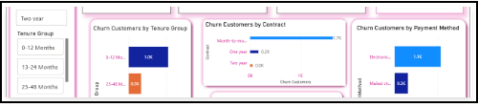



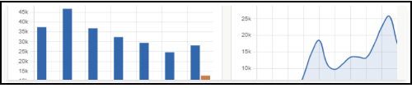




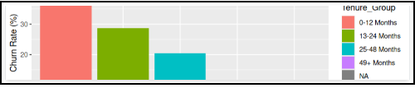
2026
- A.I. SUMMIT -
Customer Churn Analysis
Dashboard Visualizations
Total Customers
Churn Rate
7,043
27%
Components
KPI Cards
Churn Rate Gauge
Contract Type Bar Chart
Tenure Analysis
Monthly Charges Comparison
Service Usage Heatmap
Interactive Filters/Slicers

Slide 9


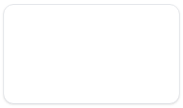
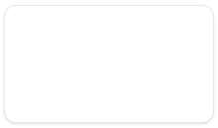


2026
- A.I. SUMMIT -
Customer Churn Analysis
Recommendations
1
2
3
4
5
Encourage long-term contracts
Improve onboarding for new customers
Bundle support-related services
Reward high-value customers
Promote automatic payment methods

Slide 10



2026
- A.I. SUMMIT -
Customer Churn Analysis
Conclusion
Final Summary
Business Impact
Contract type, tenure, monthly charges, and support services strongly influence customer retention.
Reduce customer loss
Improve customer satisfaction
Increase long-term revenue
Build targeted retention programs

